Slide 1
RANDOM VARIABLES & EXPECTATIONS
CS5330: Randomized Algorithms
Lecture 2
21/01/2020

Slide 2
Admin stuff
Week 2 problem set out
Optional problems for Weeks 1 & 2 out
Webcast
  Sorry about last week! We will go over Lecture 1 during tutorial this evening.
  Webcast starting from this week.

Slide 3
Today’s Agenda
Basic definitions: probabiity space, random variables, expectations
Applications: Freivald’s algorithm, AND/OR computation, randomized quicksort

Slide 4
Probability Space
Countable sample space $Ω$
Countable sample space Ω
Probability measure Pr$:Ω→[0,1]$
Probability measure Pr:Ω→[0,1]

Slide 5


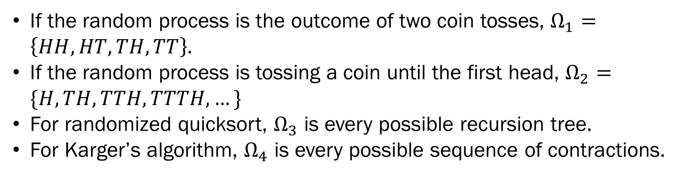
Sample space $Ω$: set of possible outcomes for a random process
If the random process is the outcome of two coin tosses, $Ω_{1}=\left\{HH, HT, TH, TT\right\}.$
If the random process is tossing a coin until the first head, $Ω_{2}=\{H, TH, TTH, TTTH, …\}$
For randomized quicksort, $Ω_{3}$ is every possible recursion tree.
For Karger’s algorithm, $Ω_{4}$ is every possible sequence of contractions.

Slide 6

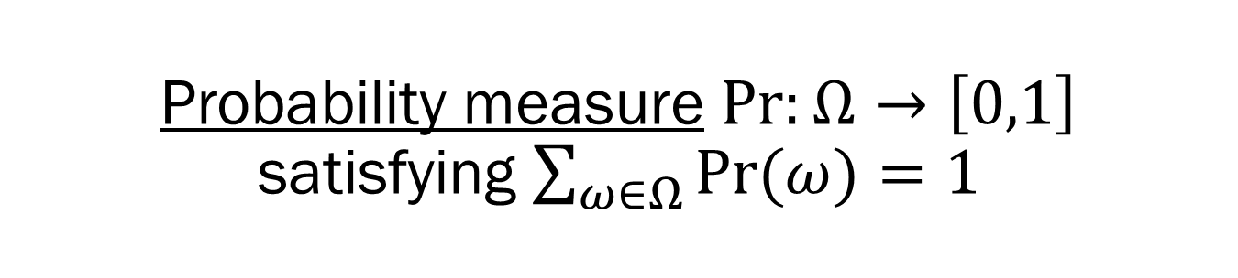
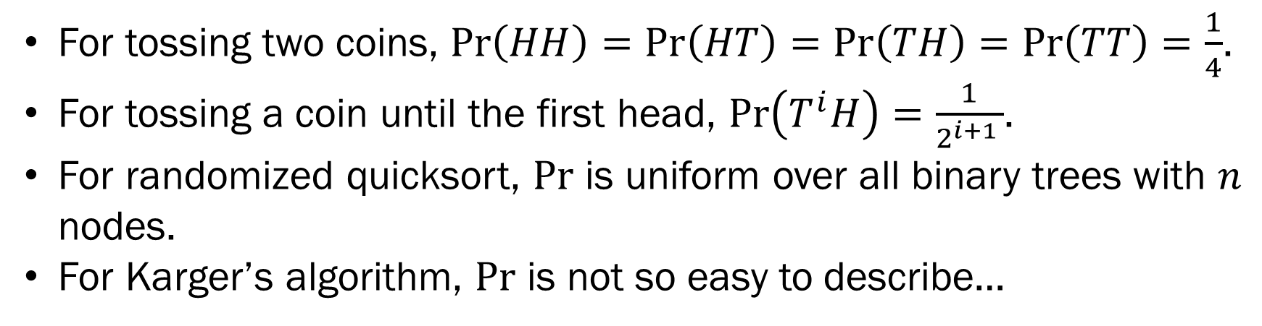
Probability measure $Pr:Ω→\left[0,1\right]$ satisfying $\sum_{ω∈Ω}{\operatorname{Pr}{(ω)}}=1$
For tossing two coins, $\operatorname{Pr}\left(HH\right)=\operatorname{Pr}\left(HT\right)=\operatorname{Pr}\left(TH\right)=\operatorname{Pr}\left(TT\right)=\frac{1}{4}$.
For tossing a coin until the first head, $\operatorname{Pr}\left(T^{i}H\right)=\frac{1}{2^{i+1 }}$.
For randomized quicksort, $\text{Pr}$ is uniform over all binary trees with $n$ nodes.
For Karger’s algorithm, $\text{Pr}$ is not so easy to describe…

Slide 7
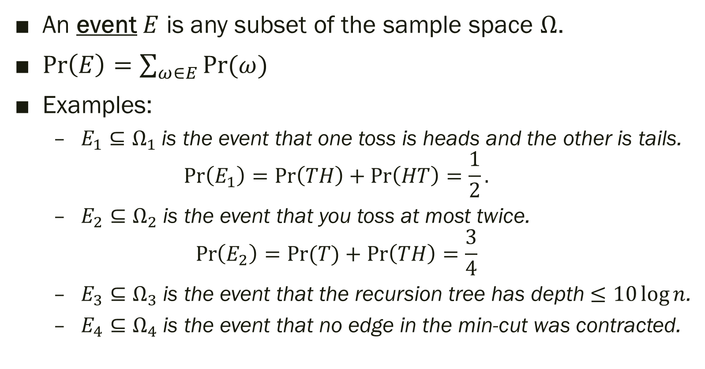
Event
An event $E$ is any subset of the sample space $Ω$.
$\operatorname{Pr}\left(E\right)=\sum_{ω∈E}{\operatorname{Pr}{(ω)}}$
Examples:
  $E_{1}⊆Ω_{1}$ is the event that one toss is heads and the other is tails.
  $\operatorname{Pr}\left(E_{1}\right)=\operatorname{Pr}\left(TH\right)+\operatorname{Pr}\left(HT\right)=\frac{1}{2}.$
  $E_{2}⊆Ω_{2}$ is the event that you toss at most twice.
  $\operatorname{Pr}\left(E_{2}\right)=\operatorname{Pr}{(T)}+\operatorname{Pr}\left(TH\right)=\frac{3}{4}$
  $E_{3}⊆Ω_{3}$ is the event that the recursion tree has depth $≤10\log{n}$.
  $E_{4}⊆Ω_{4}$ is the event that no edge in the min-cut was contracted.

Slide 8






Inclusion-Exclusion
$$E_{1}$$
$$E_{2}$$
$$Ω$$
$$\operatorname{Pr}\left(E_{1}∪E_{2}\right)=\operatorname{Pr}\left(E_{1}\right)+\operatorname{Pr}\left(E_{2}\right)−\operatorname{Pr}{(E_{1}∩E_{2})}$$

Slide 9
Union Bound
$$E_{1}$$
$$E_{2}$$
$$Ω$$
$$\operatorname{Pr}\left(E_{1}∪E_{2}\right)≤\operatorname{Pr}\left(E_{1}\right)+\operatorname{Pr}\left(E_{2}\right)$$

Slide 10


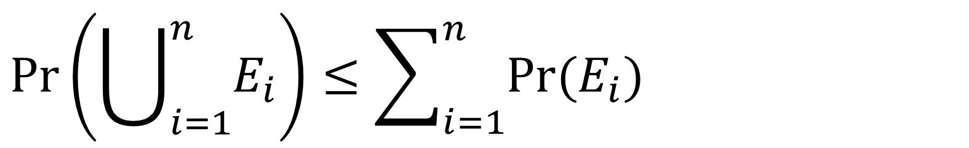





Union Bound
$$Ω$$
$$\operatorname{Pr}\left(\bigcup_{i=1}^{n}{E_{i}}\right)≤\sum_{i=1}^{n}{\operatorname{Pr}{(E_{i})}}$$

Slide 11
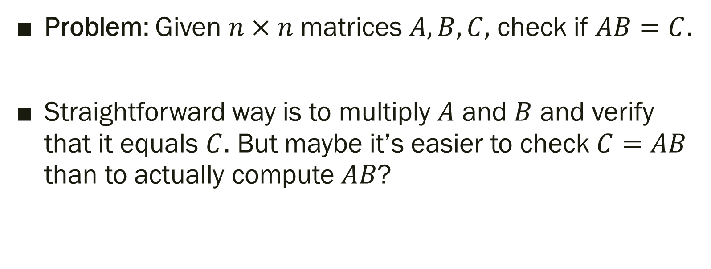
Freivald’s Algorithm
Problem: Given $n×n$ matrices $A, B, C,$ check if $AB=C$.
Straightforward way is to multiply $A$ and $B$ and verify that it equals $C$. But maybe it’s easier to check $C=AB$ than to actually compute $AB$?

Slide 12

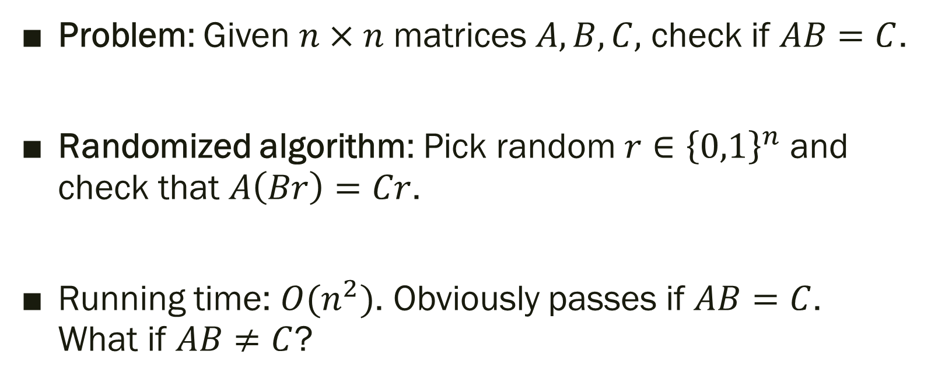
Freivald’s Algorithm
Problem: Given $n×n$ matrices $A, B, C,$ check if $AB=C$.
Randomized algorithm: Pick random $r∈{\left\{0,1\right\}}^{n}$ and check that $A\left(Br\right)=Cr$.
Running time: $O(n^{2})$. Obviously passes if $AB=C$.
What if $AB≠C$?

Slide 13
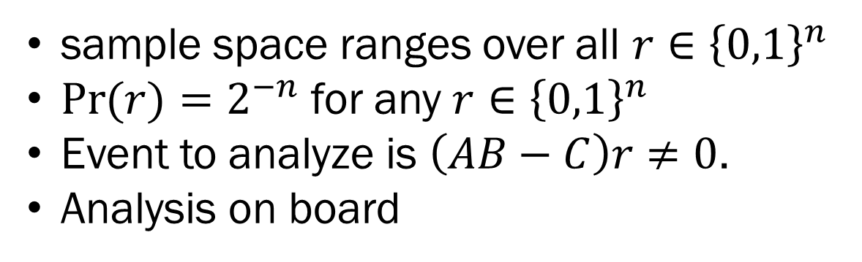
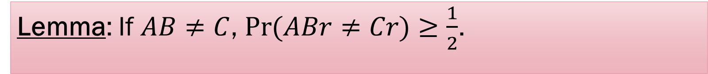
Freivald’s Algorithm
Lemma: If $AB≠C$, $\operatorname{Pr}{(ABr≠Cr)}≥\frac{1}{2}$.
sample space ranges over all $r∈{\left\{0,1\right\}}^{n}$
$\operatorname{Pr}{(r)}=2^{−n}$ for any $r∈{\left\{0,1\right\}}^{n}$
Event to analyze is $\left(AB−C\right)r≠0$.
Analysis on board

Slide 14
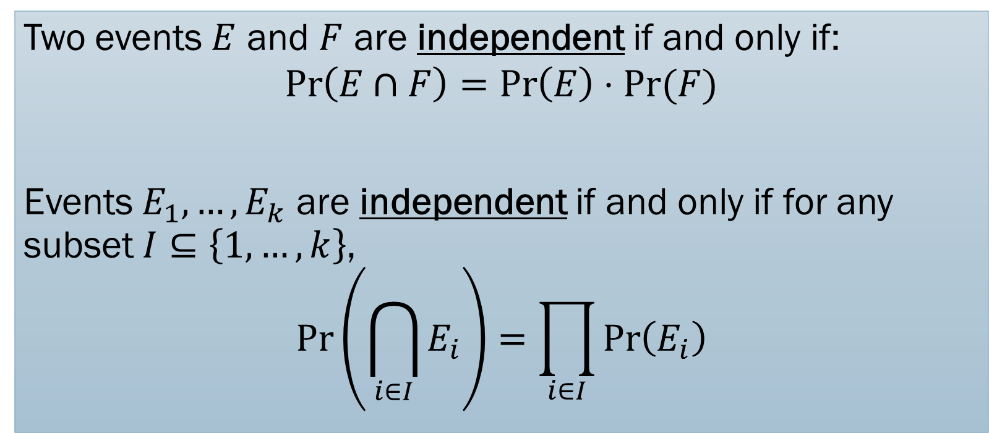
Independence
Two events $E$ and $F$ are independent if and only if:
$$\operatorname{Pr}\left(E∩F\right)=\operatorname{Pr}\left(E\right)⋅Pr⁡(F)$$
Events $E_{1},…,E_{k}$ are independent if and only if for any subset $I⊆\left\{1,…, k\right\}$,
$$\operatorname{Pr}\left(\bigcap_{i∈I}{E_{i}}\right)=\prod_{i∈I}{\operatorname{Pr}\left(E_{i}\right)}$$

Slide 15
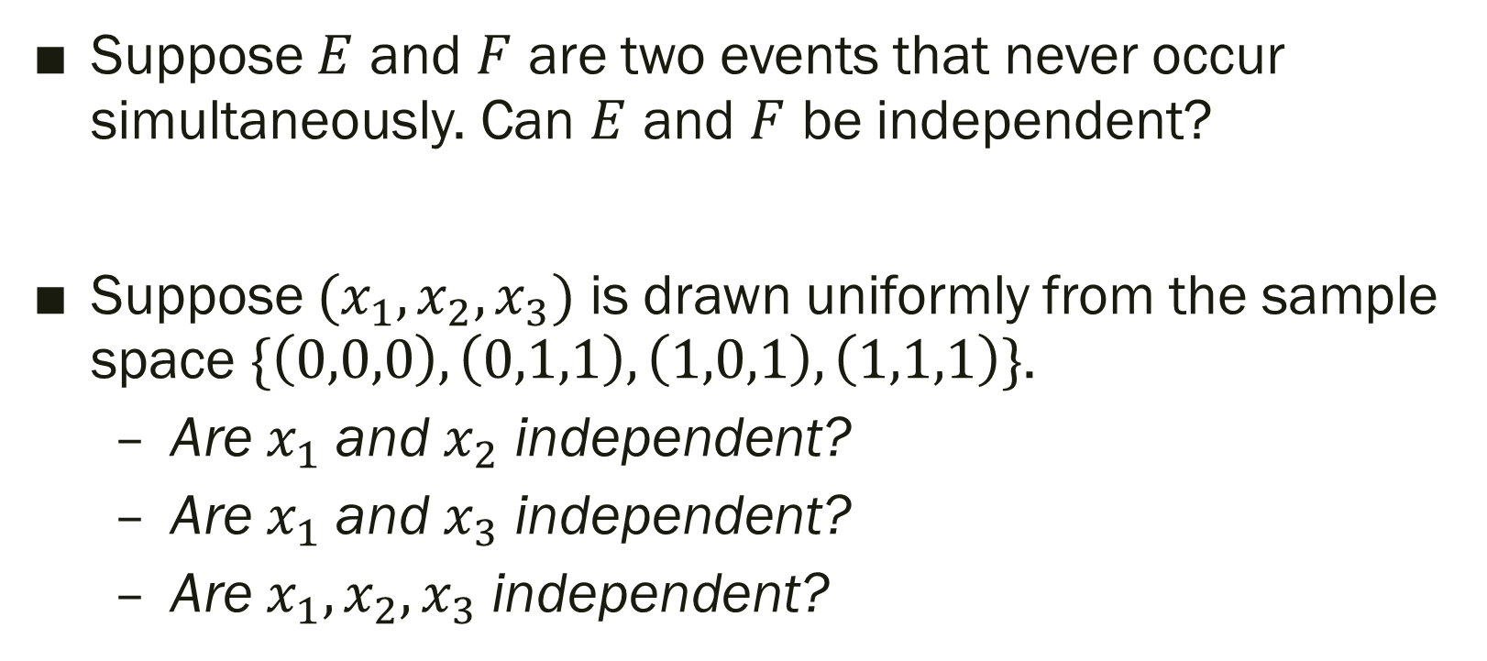
Quick Quiz
Suppose $E$ and $F$ are two events that never occur simultaneously. Can $E$ and $F$ be independent?
Suppose $(x_{1},x_{2},x_{3})$ is drawn uniformly from the sample space $\{\left(0,0,0\right),\left(0,1,1\right),\left(1,0,1\right), \left(1,1,1\right)\}$.
  Are $x_{1}$ and $x_{2}$ independent?
  Are $x_{1}$ and $x_{3}$ independent?
  Are $x_{1},x_{2},x_{3}$ independent?

Slide 16
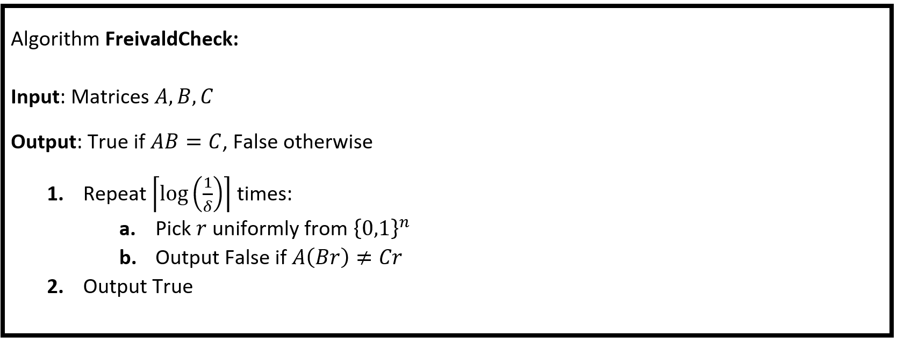
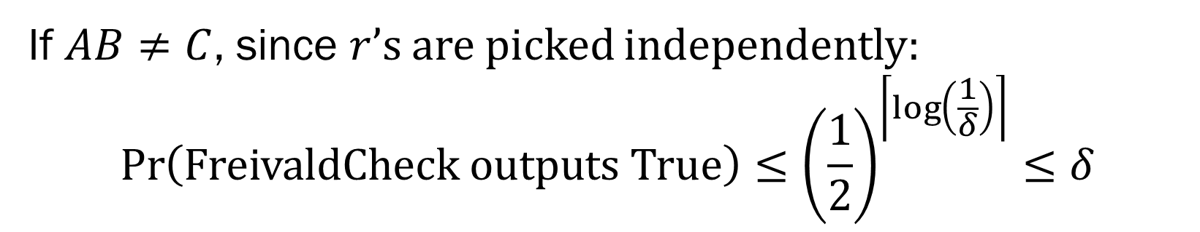
If $AB≠C$, since $r$’s are picked independently:
$$\operatorname{Pr}\left(\text{FreivaldCheck} \text{outputs} \text{True}\right)≤{\left(\frac{1}{2}\right)}^{\left\lceil \log\left(\frac{1}{δ}\right)\right\rceil }≤δ$$

Slide 17
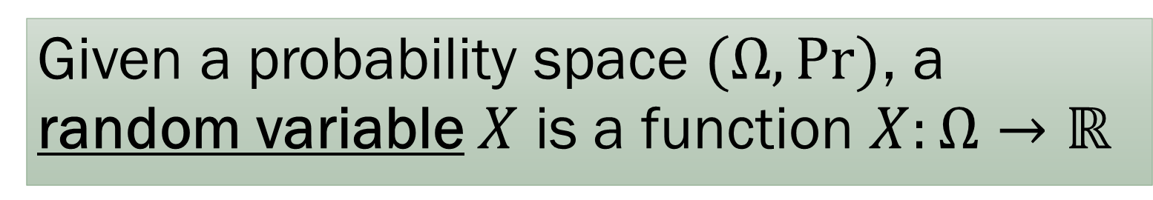
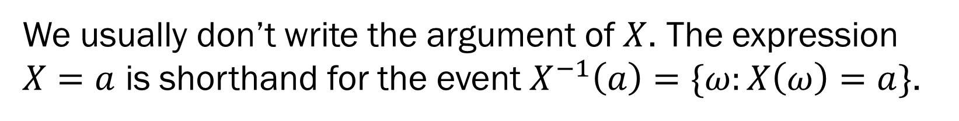
Random Variables
Given a probability space $(Ω,\text{Pr})$, a random variable $X$ is a function $X:Ω→ℝ$
We usually don’t write the argument of $X$. The expression $X=a$ is shorthand for the event $X^{−1}\left(a\right)=\{ω:X\left(ω\right)=a\}$.

Slide 18
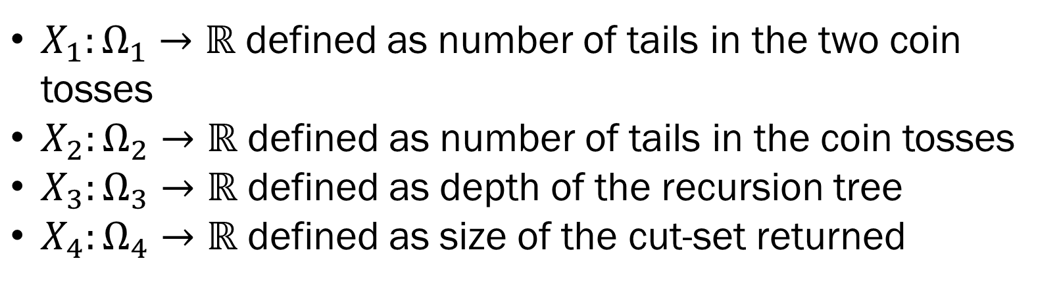
Random Variables
Given a probability space $(Ω,\text{Pr})$, a random variable $X$ is a function $X:Ω→ℝ$
$X_{1}:Ω_{1}→ℝ$ defined as number of tails in the two coin tosses
$X_{2}:Ω_{2}→ℝ$ defined as number of tails in the coin tosses
$X_{3}:Ω_{3}→ℝ$ defined as depth of the recursion tree
$X_{4}:Ω_{4}→ℝ$ defined as size of the cut-set returned

Slide 19
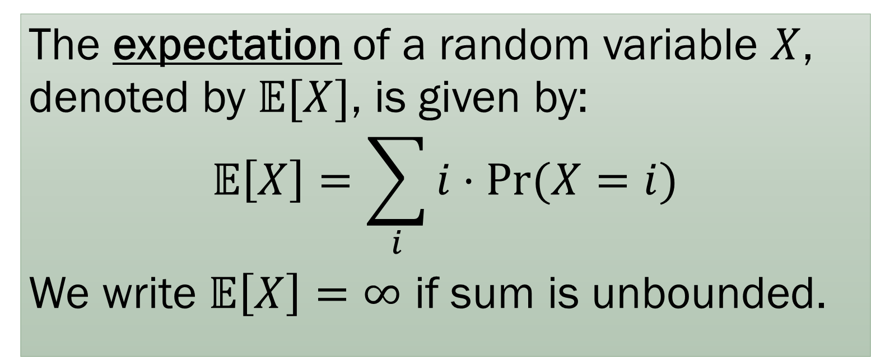
Expectations
The expectation of a random variable $X$, denoted by $𝔼[X]$, is given by:
$$𝔼\left[X\right]=\sum_{i}{i⋅Pr⁡(X=i)}$$
We write $𝔼\left[X\right]=∞$ if sum is unbounded.

Slide 20
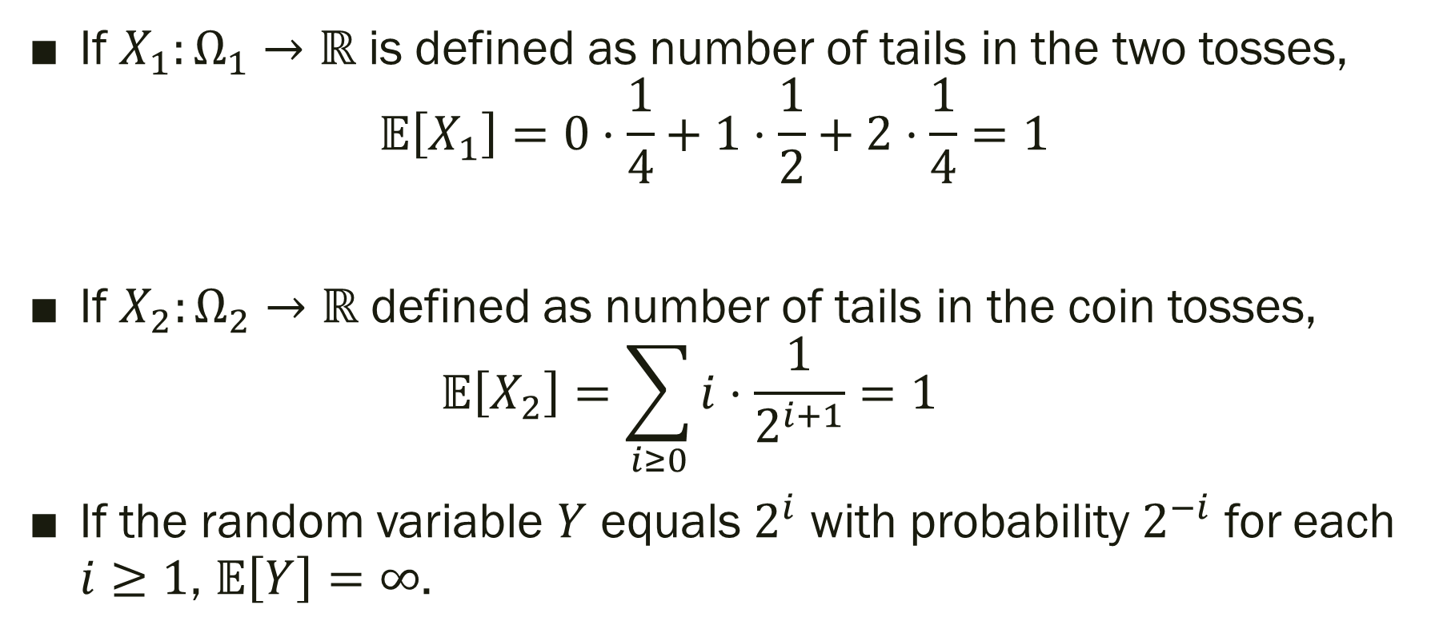
Expectations
If $X_{1}:Ω_{1}→ℝ$ is defined as number of tails in the two tosses,
$𝔼\left[X_{1}\right]=0⋅\frac{1}{4}+1⋅\frac{1}{2}+2⋅\frac{1}{4}=1$
If $X_{2}:Ω_{2}→ℝ$ defined as number of tails in the coin tosses,
$𝔼\left[X_{2}\right]=\sum_{i≥0}{i⋅\frac{1}{2^{i+1}}}=1$
If the random variable $Y$ equals $2^{i}$ with probability $2^{−i}$ for each $i≥1$, $𝔼\left[Y\right]=∞$.

Slide 21
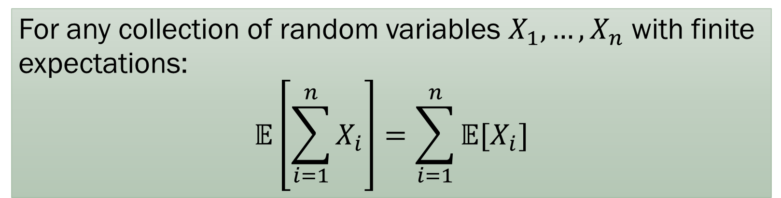
Linearity of Expections
For any collection of random variables $X_{1},…, X_{n}$ with finite expectations:
$$𝔼\left[\sum_{i=1}^{n}{X_{i}}\right]=\sum_{i=1}^{n}{𝔼[X_{i}]}$$
Extends to infinite number of variables also. See exercises.

Slide 22
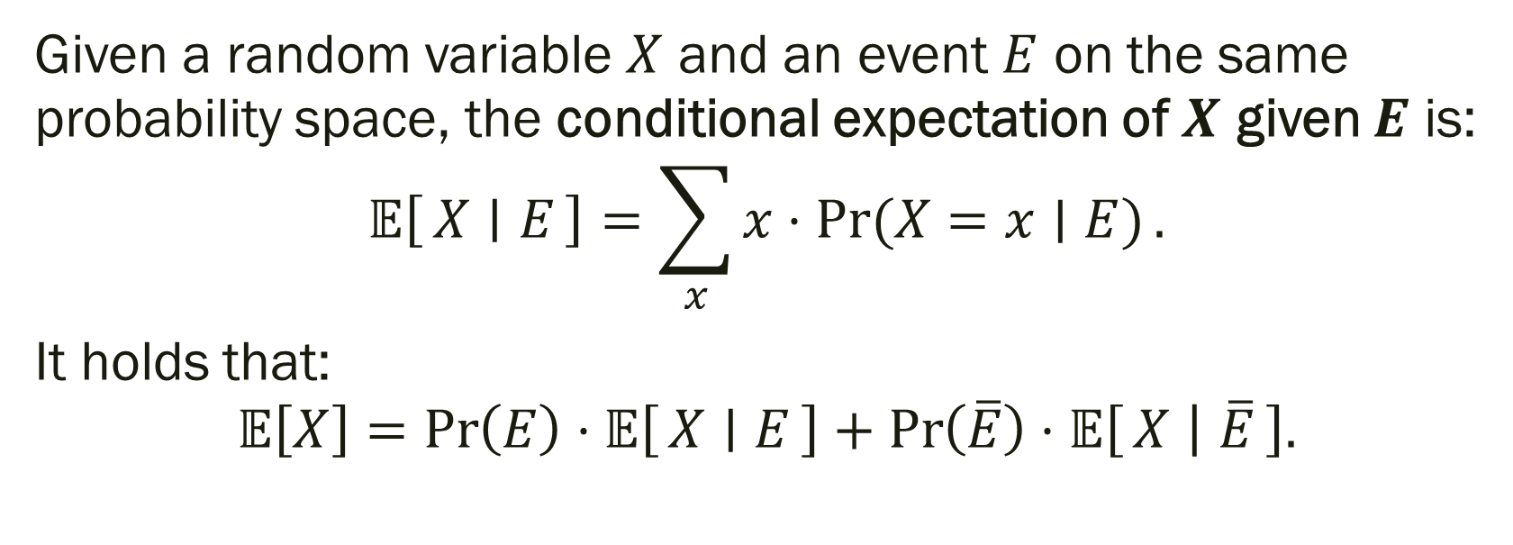
Conditional Expectations
Given a random variable $X$ and an event $E$ on the same probability space, the conditional expectation of $X$ given $E$ is:
$$𝔼\left[X ∣ E\right]=\sum_{x}{x⋅Pr⁡(X=x∣E)}.$$
It holds that:
$$𝔼\left[X\right]=\operatorname{Pr}\left(E\right)⋅𝔼\left[X ∣ E\right]+\operatorname{Pr}\left(\overline{E}\right)⋅𝔼\left[X ∣ \overline{E}\right].$$

Slide 23
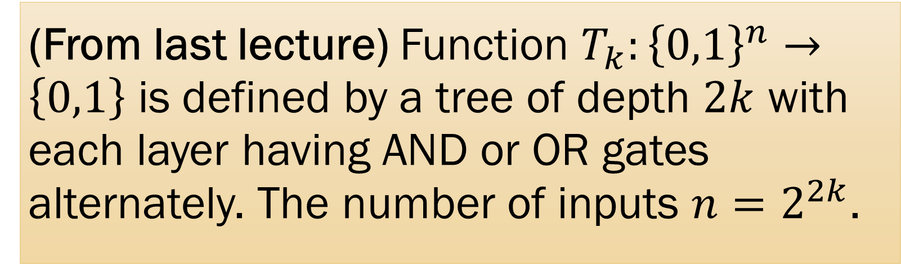
AND/OR Tree
(From last lecture) Function $T_{k}:{\left\{0,1\right\}}^{n}→\left\{0,1\right\}$ is defined by a tree of depth $2k$ with each layer having AND or OR gates alternately. The number of inputs $n=2^{2k}$.

Slide 24

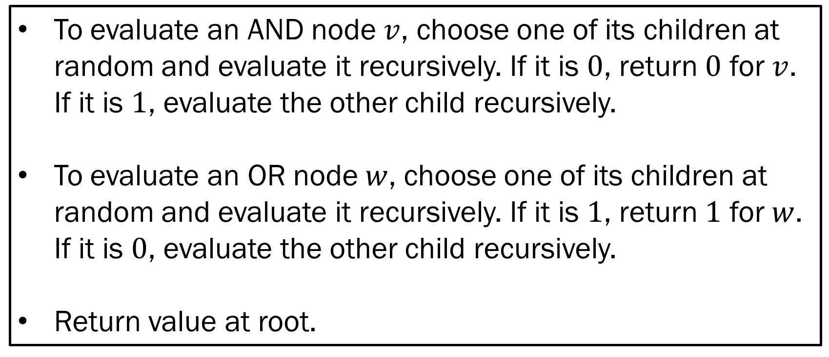
Randomized Algorithm for $T_{k}$
To evaluate an AND node $v$, choose one of its children at random and evaluate it recursively. If it is $0$, return $0$ for $v$. If it is $1$, evaluate the other child recursively.
To evaluate an OR node $w$, choose one of its children at random and evaluate it recursively. If it is $1$, return $1$ for $w$. If it is $0$, evaluate the other child recursively.
Return value at root.

Slide 25
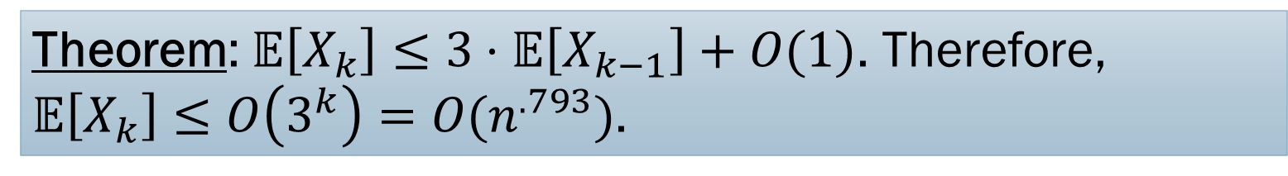
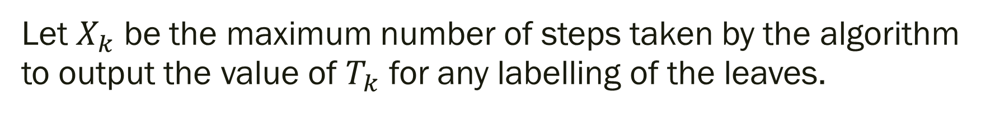
Analysis
Let $X_{k}$ be the maximum number of steps taken by the algorithm to output the value of $T_{k}$ for any labelling of the leaves.
Theorem: $𝔼\left[X_{k}\right]≤3⋅𝔼\left[X_{k−1}\right]+O(1)$. Therefore, $𝔼\left[X_{k}\right]≤O\left(3^{k}\right)=O(n^{.793})$.

Slide 26


















Proof
AND
OR
OR
$$T_{k−1}$$
$$T_{k−1}$$
$$T_{k−1}$$
$$T_{k−1}$$

Slide 27
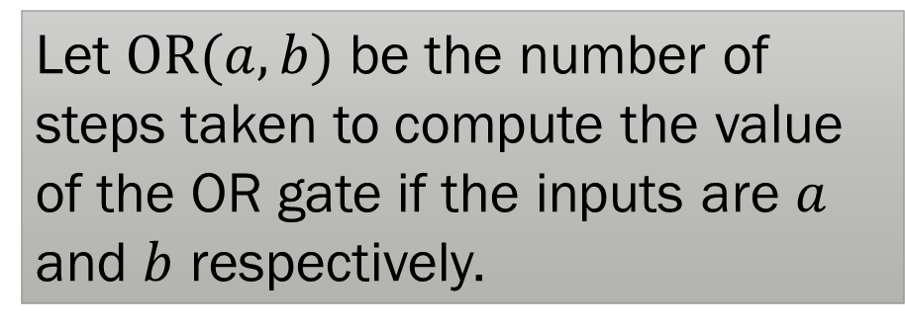
Proof
Let $\text{OR}(a,b)$ be the number of steps taken to compute the value of the OR gate if the inputs are $a$ and $b$ respectively.
OR
$$𝔼\left[OR\left(0,0\right)\right]≤2⋅𝔼\left[X_{k−1}\right]+O\left(1\right)$$
𝔼[𝑂𝑅(0,0)]≤2⋅𝔼[𝑋_(𝑘−1) ]+𝑂(1)
$$𝔼\left[OR\left(1,0\right)\right]≤1.5⋅𝔼\left[X_{k−1}\right]+O\left(1\right)$$
𝔼[𝑂𝑅(1,0)]≤1.5⋅𝔼[𝑋_(𝑘−1) ]+𝑂(1)
$$𝔼\left[OR\left(0,1\right)\right]≤1.5⋅𝔼\left[X_{k−1}\right]+O\left(1\right)$$
𝔼[𝑂𝑅(0,1)]≤1.5⋅𝔼[𝑋_(𝑘−1) ]+𝑂(1)
$$𝔼\left[OR\left(1,1\right)\right]≤𝔼\left[X_{k−1}\right]+O(1)$$
𝔼[𝑂𝑅(1,1)]≤𝔼[𝑋_(𝑘−1) ]+𝑂(1)
$$T_{k−1}$$
$$T_{k−1}$$

Slide 28
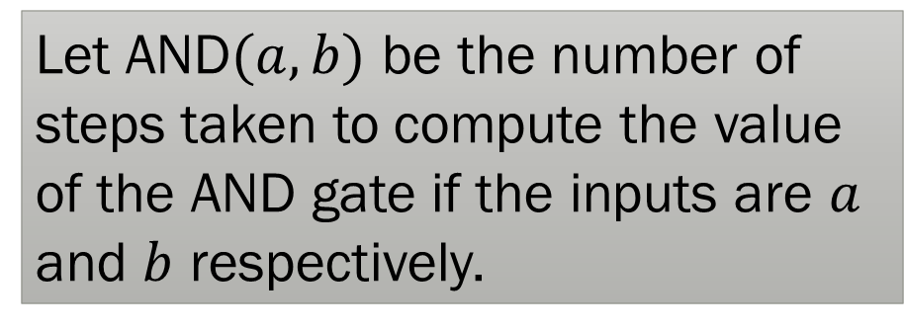
Proof
Let AND$(a,b)$ be the number of steps taken to compute the value of the AND gate if the inputs are $a$ and $b$ respectively.
AND
OR
OR
$$𝔼\left[AND\left(0,0\right)\right]≤2⋅𝔼\left[X_{k−1}\right]+O\left(1\right)$$
𝔼[𝐴𝑁𝐷(0,0)]≤2⋅𝔼[𝑋_(𝑘−1) ]+𝑂(1)
$$𝔼\left[AND\left(1,0\right)\right]≤2.75⋅𝔼\left[X_{k−1}\right]+O\left(1\right)$$
𝔼[𝐴𝑁𝐷(1,0)]≤2.75⋅𝔼[𝑋_(𝑘−1) ]+𝑂(1)
$$𝔼\left[AND\left(0,1\right)\right]≤2.75⋅𝔼\left[X_{k−1}\right]+O\left(1\right)$$
𝔼[𝐴𝑁𝐷(0,1)]≤2.75⋅𝔼[𝑋_(𝑘−1) ]+𝑂(1)
$$𝔼\left[AND\left(1,1\right)\right]≤3⋅𝔼\left[X_{k−1}\right]+O\left(1\right)$$
𝔼[𝐴𝑁𝐷(1,1)]≤3⋅𝔼[𝑋_(𝑘−1) ]+𝑂(1)
$$𝔼\left[OR\left(0,0\right)\right]≤2⋅𝔼\left[X_{k−1}\right]+O\left(1\right)$$
𝔼[𝑂𝑅(0,0)]≤2⋅𝔼[𝑋_(𝑘−1) ]+𝑂(1)
$$𝔼\left[OR\left(1,0\right)\right]≤1.5⋅𝔼\left[X_{k−1}\right]+O\left(1\right)$$
𝔼[𝑂𝑅(1,0)]≤1.5⋅𝔼[𝑋_(𝑘−1) ]+𝑂(1)
$$𝔼\left[OR\left(0,1\right)\right]≤1.5⋅𝔼\left[X_{k−1}\right]+O\left(1\right)$$
𝔼[𝑂𝑅(0,1)]≤1.5⋅𝔼[𝑋_(𝑘−1) ]+𝑂(1)
$$𝔼\left[OR\left(1,1\right)\right]≤𝔼\left[X_{k−1}\right]+O(1)$$
𝔼[𝑂𝑅(1,1)]≤𝔼[𝑋_(𝑘−1) ]+𝑂(1)

Slide 29
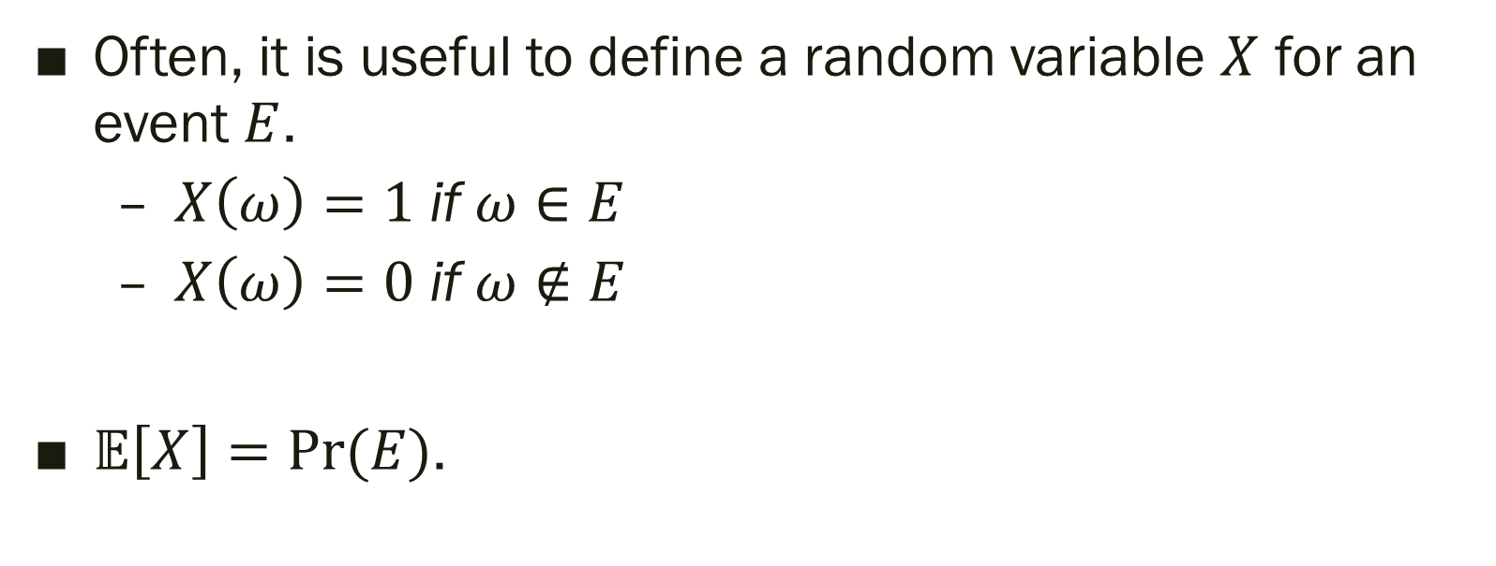
Indicator Random Variables
Often, it is useful to define a random variable $X$ for an event $E$.
  $X\left(ω\right)=1$ if $ω∈E$
  $X\left(ω\right)=0$ if $ω∉E$
$𝔼\left[X\right]=Pr⁡(E)$.

Slide 30
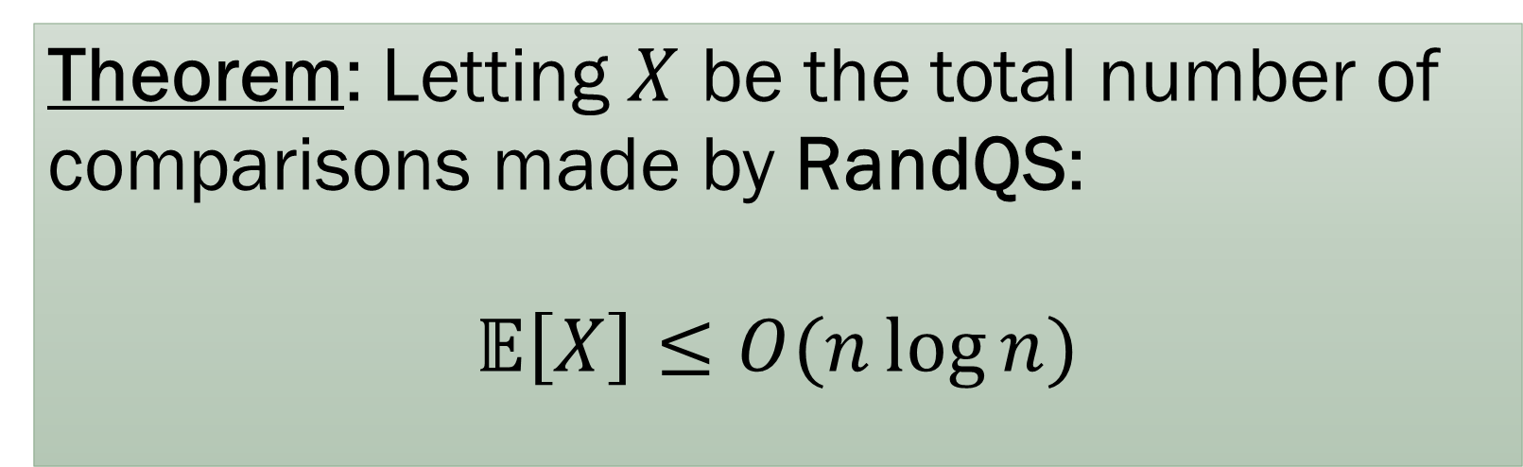
Randomized Quicksort Analysis
Theorem: Letting $X$ be the total number of comparisons made by RandQS:
$$𝔼\left[X\right]≤O(n\log{n})$$

Slide 31
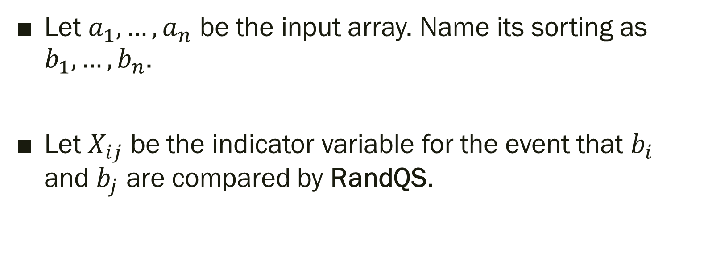
Randomized Quicksort Analysis
Let $a_{1},…, a_{n}$ be the input array. Name its sorting as $b_{1},…, b_{n}$.
Let $X_{ij}$ be the indicator variable for the event that $b_{i}$ and $b_{j}$ are compared by RandQS.

Slide 32
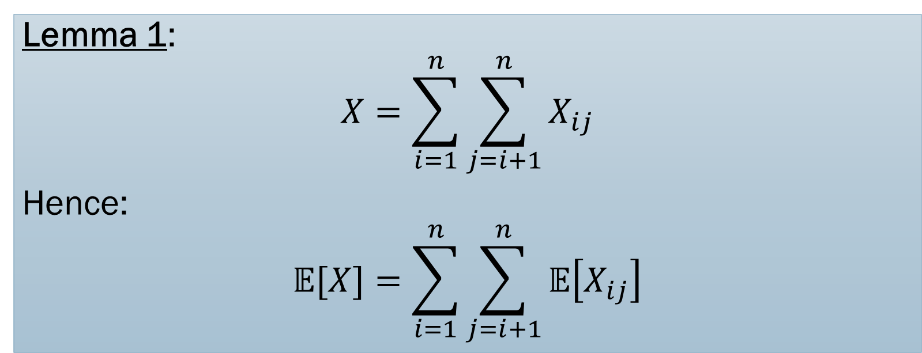

Randomized Quicksort Analysis
Lemma 1:
$$X=\sum_{i=1}^{n}{\sum_{j=i+1}^{n}{X_{ij}}}$$
Hence:
$$𝔼[X]=\sum_{i=1}^{n}{\sum_{j=i+1}^{n}{𝔼\left[X_{ij}\right]}}$$

Slide 33
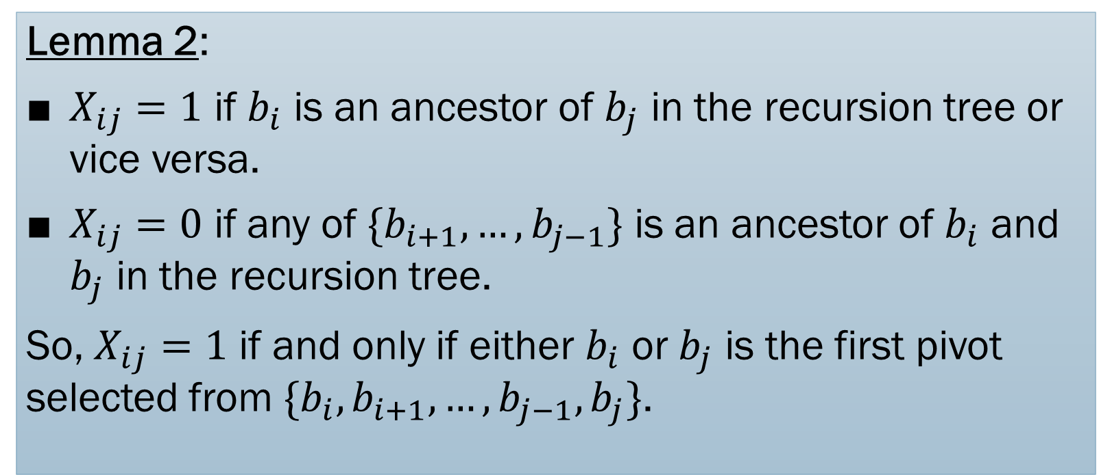
Randomized Quicksort Analysis
Lemma 2:
$X_{ij}=1$ if $b_{i}$ is an ancestor of $b_{j}$ in the recursion tree or vice versa.
$X_{ij}=0$ if any of $\{b_{i+1},…, b_{j−1}\}$ is an ancestor of $b_{i}$ and $b_{j}$ in the recursion tree.
So, $X_{ij}=1$ if and only if either $b_{i}$ or $b_{j}$ is the first pivot selected from $\{b_{i}, b_{i+1},…, b_{j−1},b_{j}\}$.

Slide 34
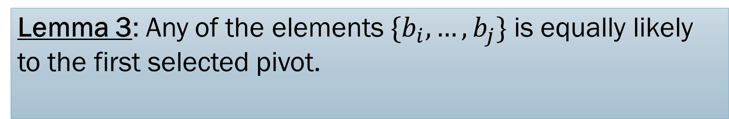
Randomized Quicksort Analysis
Lemma 3: Any of the elements $\{b_{i},…, b_{j}\}$ is equally likely to the first selected pivot.

Slide 35
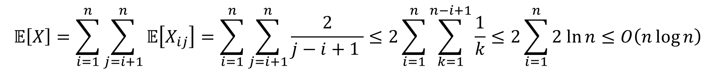
Randomized Quicksort Analysis
Putting together the three lemmas:
$$𝔼\left[X\right]=\sum_{i=1}^{n}{\sum_{j=i+1}^{n}{𝔼\left[X_{ij}\right]}}=\sum_{i=1}^{n}{\sum_{j=i+1}^{n}{\frac{2}{j−i+1 }}≤2\sum_{i=1}^{n}{\sum_{k=1}^{n−i+1}{\frac{1}{k}}}≤2\sum_{i=1}^{n}{2 ln{n}}≤O\left(n\log{n}\right)}$$

Slide 36

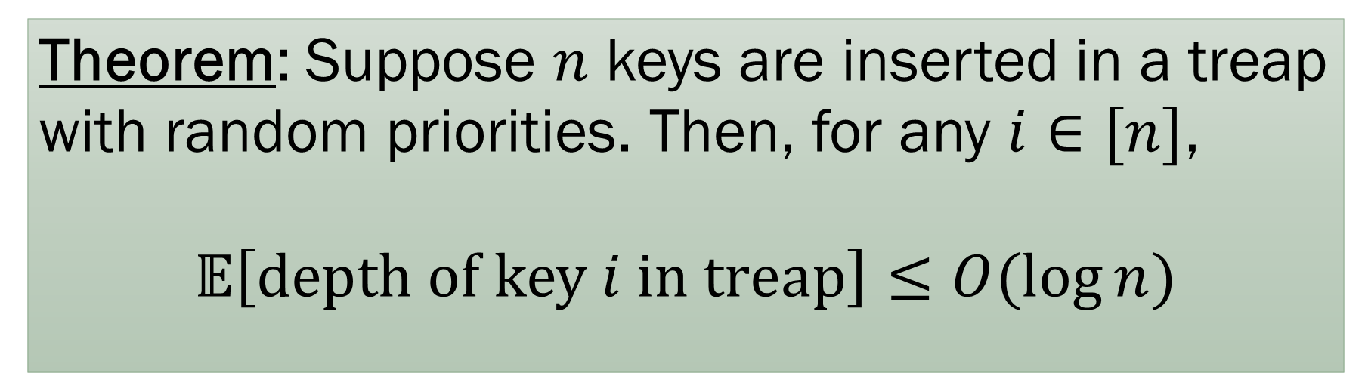
Treap Analysis
Theorem: Suppose $n$ keys are inserted in a treap with random priorities. Then, for any $i∈[n]$,
$$𝔼\left[\text{depth} \text{of} \text{key} i \text{in} \text{treap}\right]≤O(\log{n})$$
Similar to quicksort analysis, but now we count number of ancestors of $i$ in the treap. See problem set!

Slide 37
Takeaways
To do a formal analysis, you need to be explicit and clear about the probability space, events, and random variables involved.
Linearity of expectations, conditional expectations, and indicator variables are extremely helpful in analyzing expectations.
Next time, we see how to make stronger statements than a bound on the expectation.

